Slide 1
Data 602 final project: New York house price Jiaxin ZHeng

Slide 2
About THE DATA:
This data is about the prices of New York houses, it includes information and valuable such as house type, prices, number of bedrooms, bathrooms, and property square footage, addresses, state, and geographical coordinates
Kaggle: https://www.kaggle.com/datasets/nelgiriyewithana/new-york-housing-market/data

Slide 3
why is this relevant to my industry?
This is relevant to me because I work as an interior designer in an architectural firm. I understand how everyone wants to design their own dream house. On other hand, I also understand the real estate market is important, and understanding housing price trends, and location is essential for buyers. In this project allows to make informed decisions to solve real-world problems.

Slide 4
Research Questions:
How do housing prices vary across different neighborhoods or locations?
2. What factors influence housing prices the most?

Slide 5
I. View the data

Slide 6
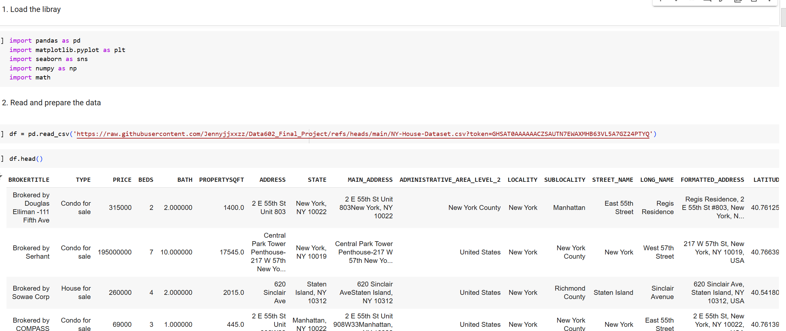

Slide 7
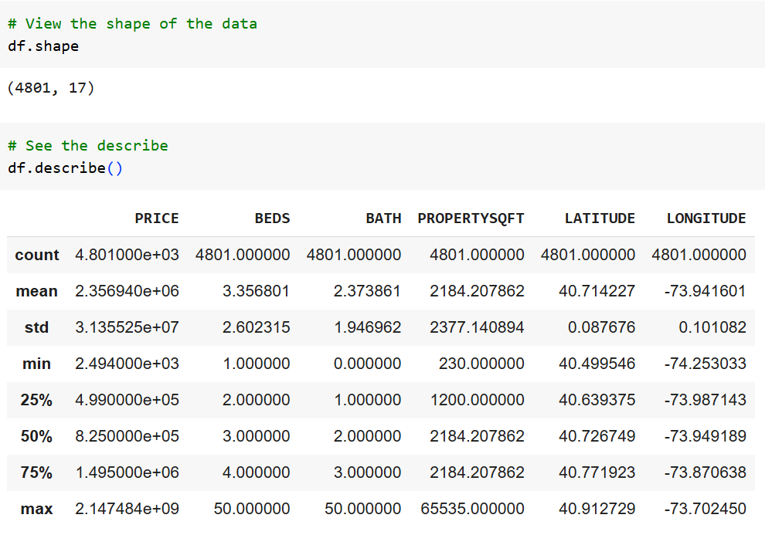
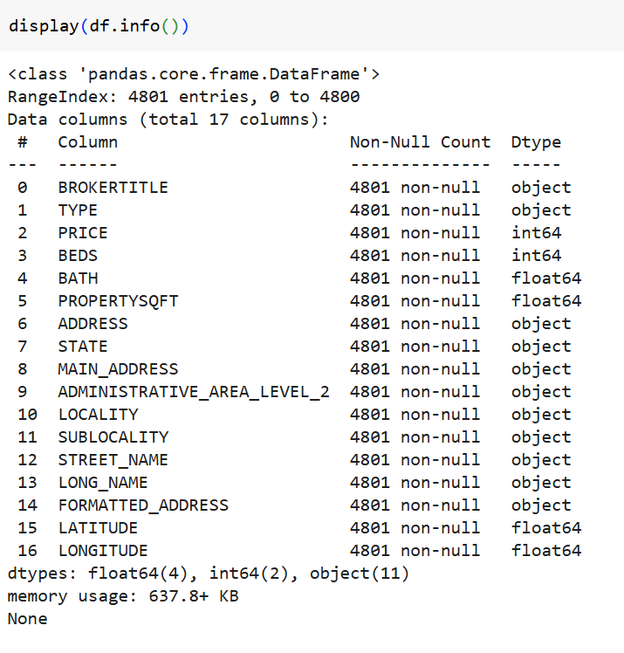

Slide 8
II. Tidy the data

Slide 9
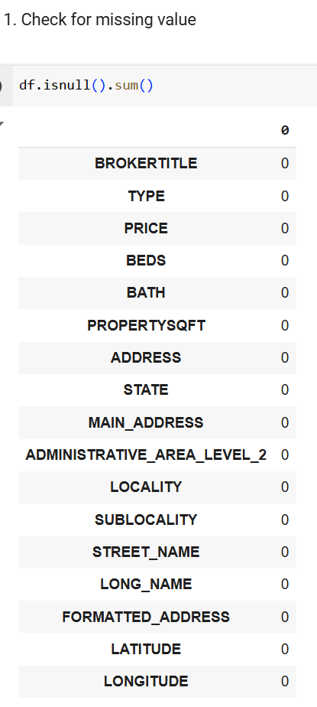

Slide 10
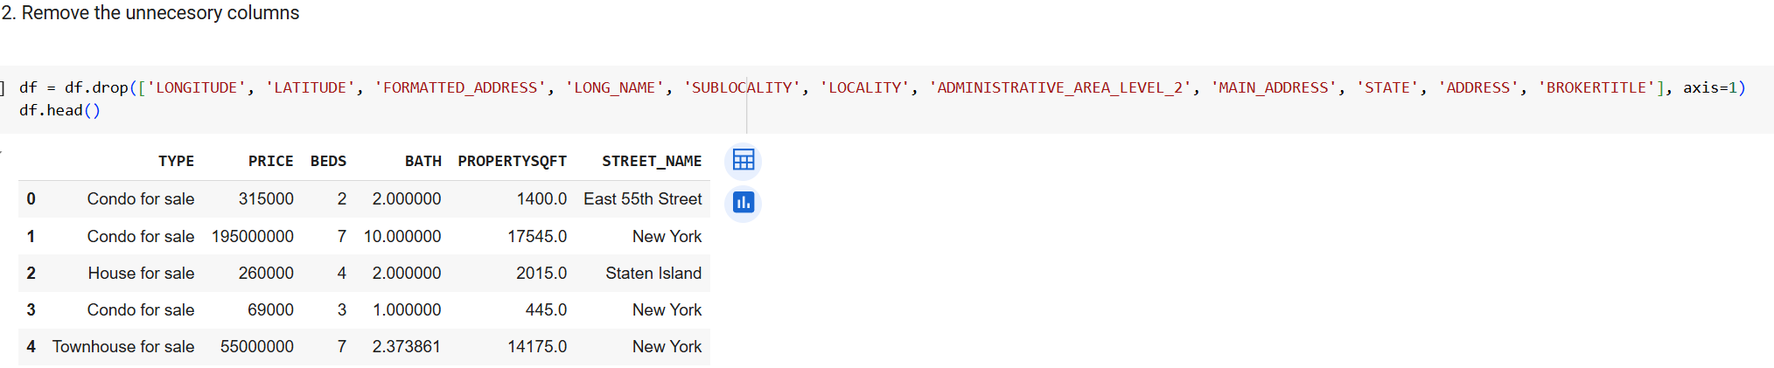
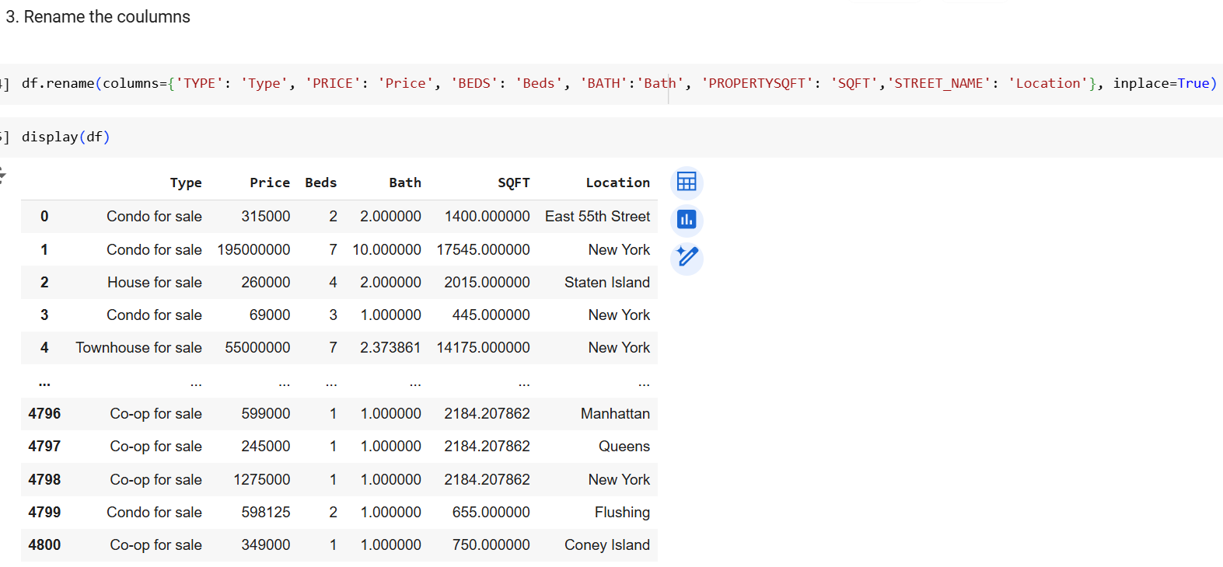

Slide 11
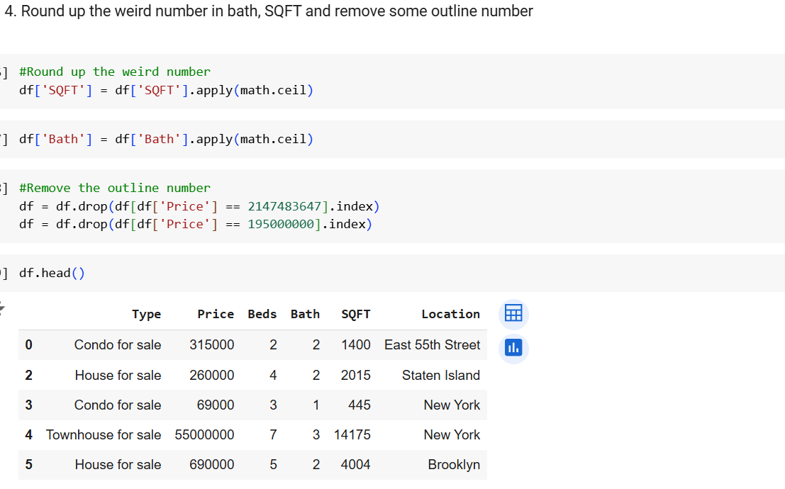

Slide 12
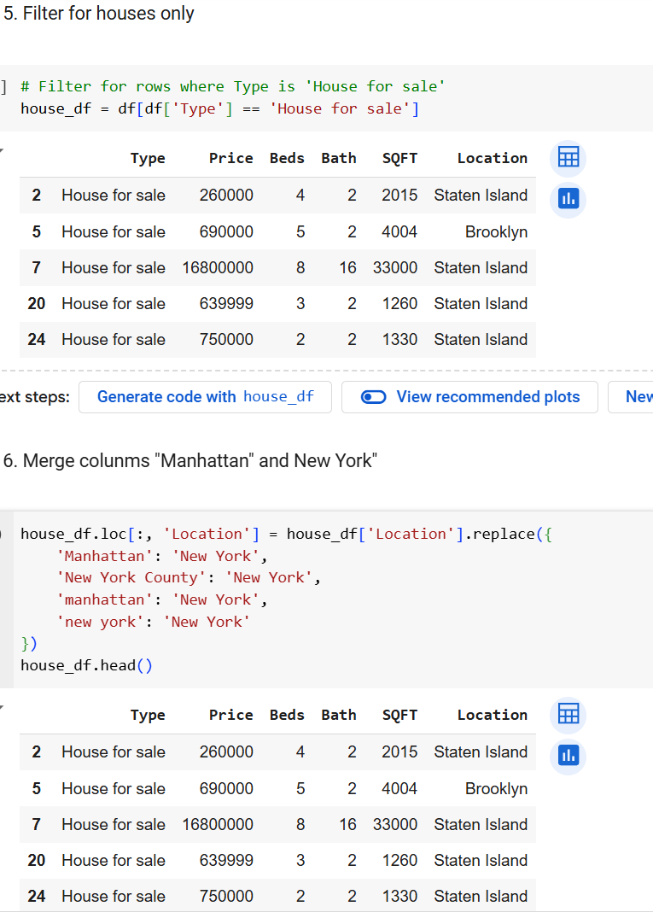

Slide 13
III. EDA

Slide 14
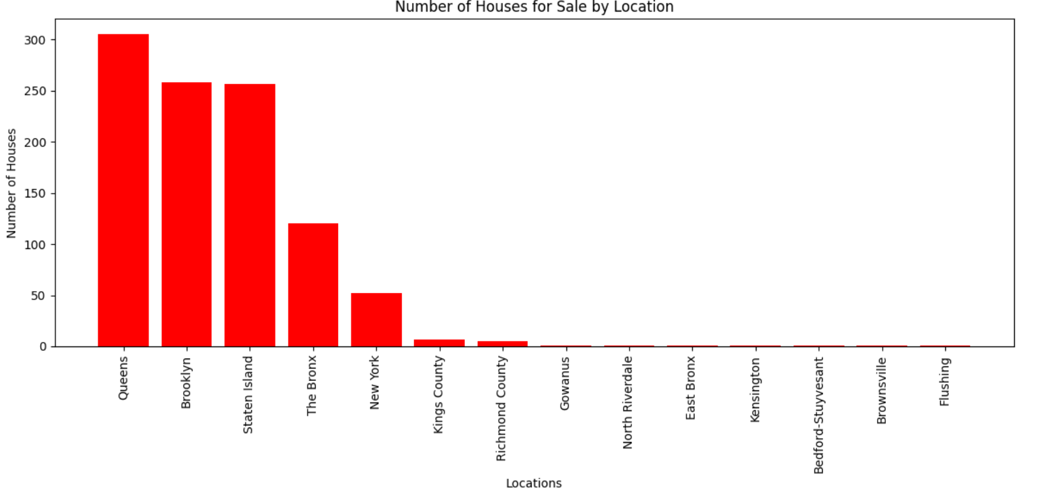

Slide 15
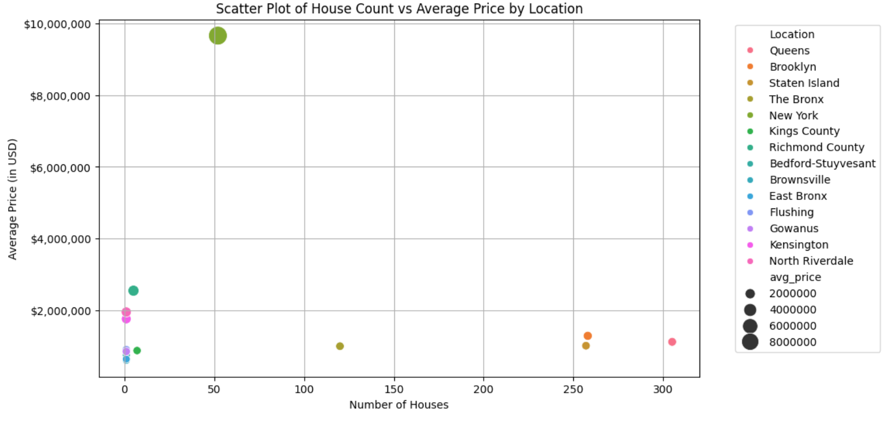

Slide 16
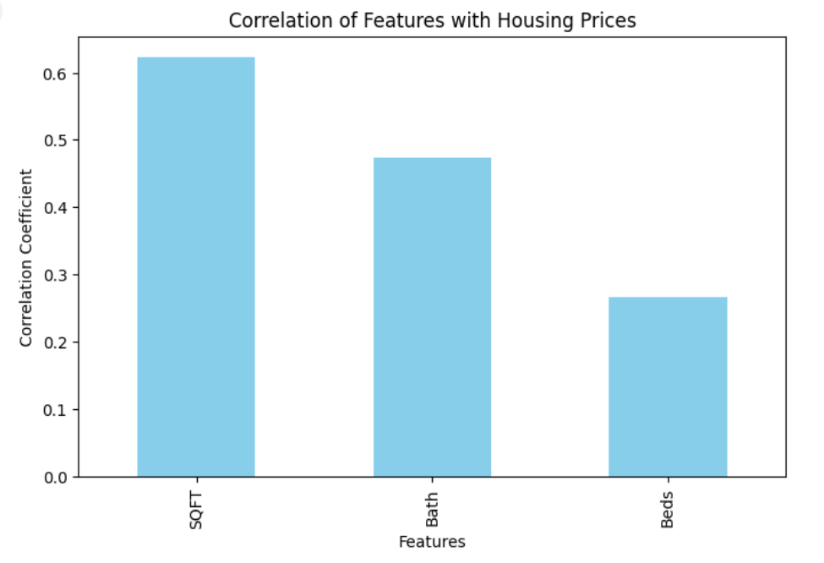

Slide 17
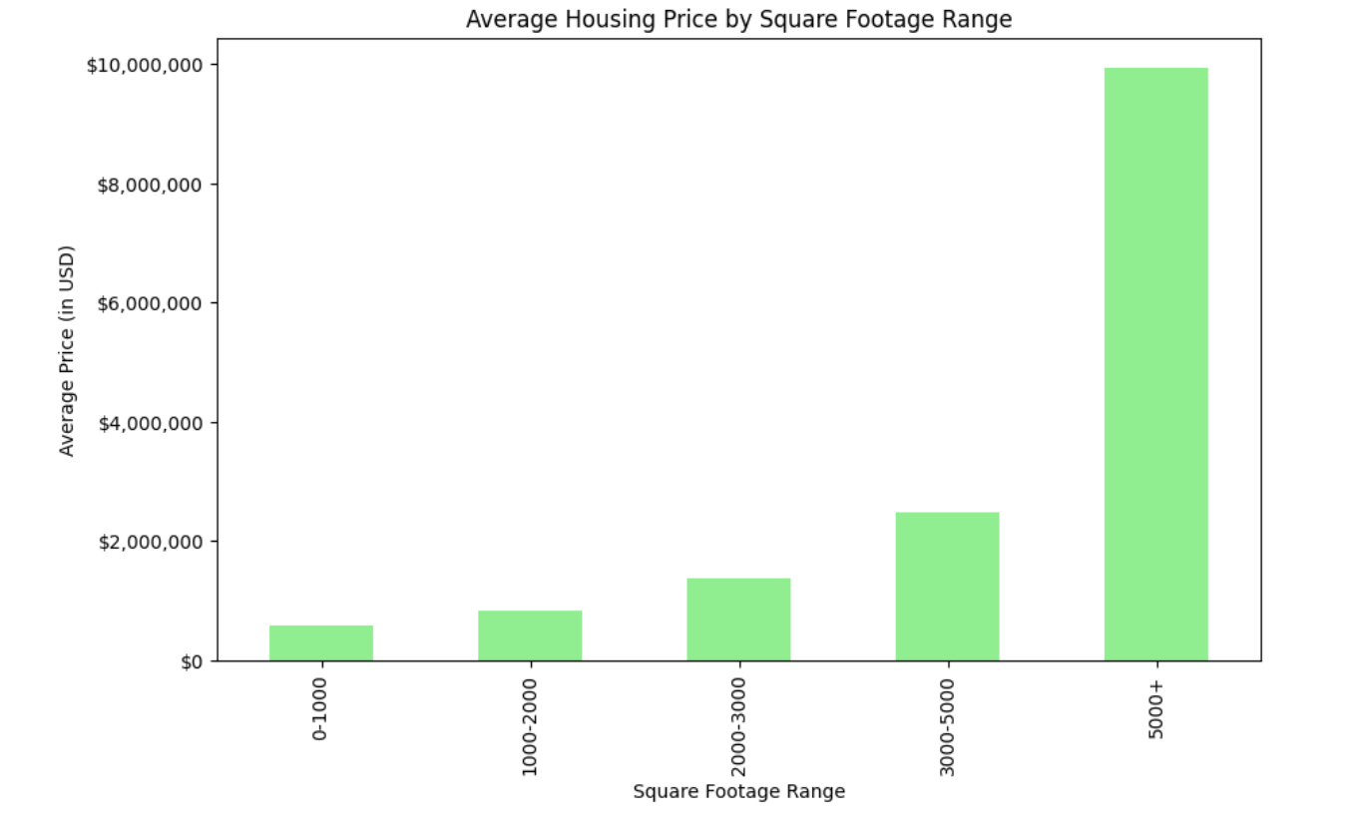

Slide 18
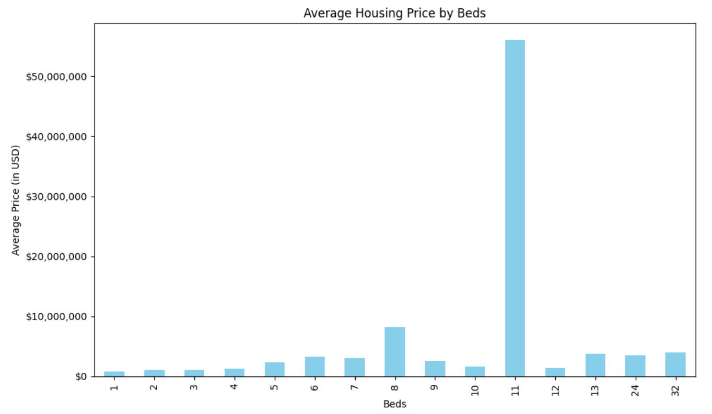

Slide 19
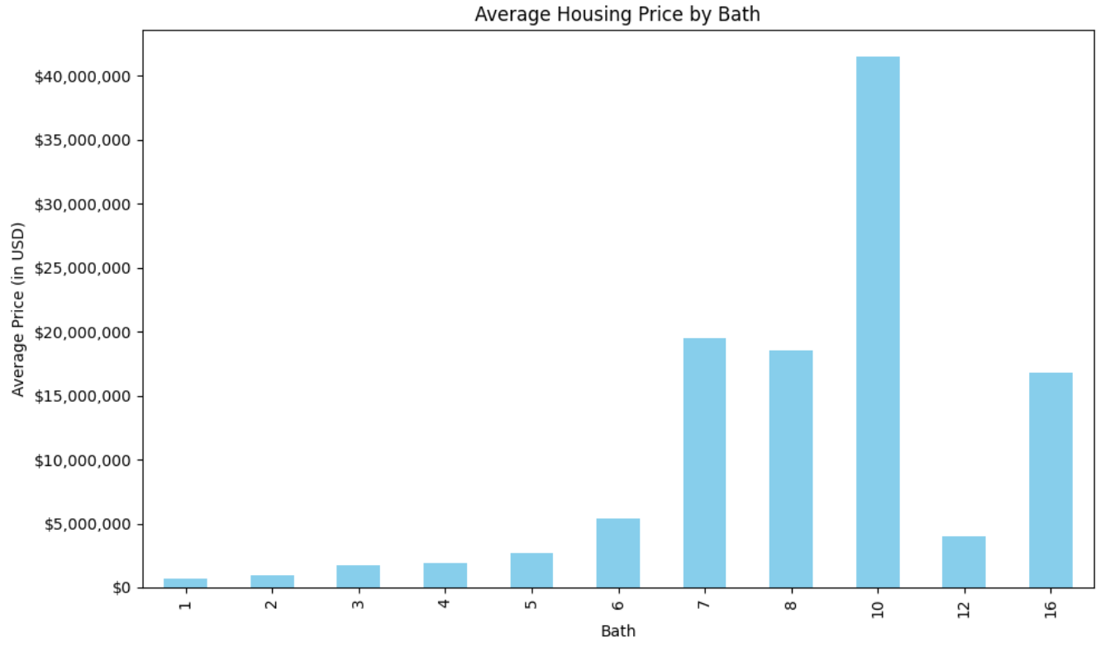

Slide 20
Summary:
The dataset provides insights into New York housing trends, highlighting that the Queens area has the most houses for sale, second Brooklyn and third Staten Island.
Queens offers affordable prices, and New York (including Manhattan) has the highest prices but limited availability.
Square footage is the key factors influencing house prices
Those with 11 bedrooms and 10 bathrooms significantly higher prices in house too

Slide 21
THANK YOU

